Slide 1
Twitter Sentiment Analysis of Presidential elections 2016
Krishna Chaitanya Dodda – krd150230
Srinivas Varupula - sxv152730
Venkata Sai Chaitanya Vaddella vxv150530

Slide 2
Project Description
Goal- Predict the potential candidate for presidency based on Sentiment Analysis of tweets.
Analyzed tweets for a series of 4 days before the final election day.
Searched by keywords – ‘trump’ , ‘presidentialelection2016’ , ‘Hillary’ etc
Language used – Java
Tools – Stanford NLP toolkit
Backend Storage - mySQL

Slide 3
Workflow
Tweet Extractor
Tweet Preprocessor
Tweet Sentiment Analyzer
Results aggregator

Slide 4
Tweet Extractor
Stage to pull out raw tweets from twitter
Crucial stage as it is essential for data collection.
Use twitter4j library
Twitter search API
Main challenge was to beat the twitter limit on access
Collected nearly a million tweets
Extracted only those tweets which had location information

Slide 5
Tweet Preprocessor
Tokenizer
Remove usertags
Lemmatization
Remove unwanted words, urls

Slide 6
Tweet Sentiment Analyzer and Results aggregator
Sentiment analysis was done for each tweet using Stanford NLP toolkit
Sentiments generated had a scale from 0 to 4 with 4 being a positive sentiment
Sentiment was also determined by analyzing the hashtags
Eg: popular hashtags like #MAGA #votefortrump #crookedHillary meant a positive sentiment for trump
A sentiment score of 2 meant the voter was neutral
All sentiments were aggregated
Results determined for each state and for country as a whole

Slide 7
Results
Popular Vote
 | Predicted | Actual
Trump | 0.304 | 0.475
Hillary | 0.493 | 0.477
Neutral | 0.203 | 0.048

Slide 8
Was it a failure of the model? NO
Dataset
The dataset that is considered is solely based on twitter feed and for only 5 days
This is not the entire population sample space and not representing a wider time frame
Also, some part of the dataset is yet to be run
The neutral voters
The model calculated the neutrality of the voter when sentiment is given a value of 2.
Reality is that most neutral voters tend to make a choice at time of voting
The predicted value of 0.22 for neutral voters was most likely capturing the vote share of swing voters who favored trump
Popular vote prediction is not the right way to proceed in a winner takes all political setup

Slide 9
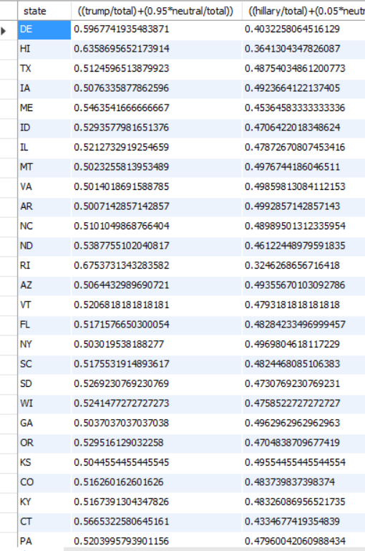
Statewise Share

Slide 10
Conclusion
The model on a closer look gives a much accurate picture of the electoral outcome
The model accurately predicts the outcome of the elections in more urban states like
CA – 0.54 for Hillary (actual 0.61)
NJ – 0.54 for Hillary ( actual 0.55)
Our Conclusion
Election is too close to be predicted but model can be a barometer for trend picking
– SWING VOTERS / Swing States
The Presidential Race was won because of the swing voters. We calculated that if Donald Trump had received nearly all of the neutral voter’s vote, he would have crossed the majority electoral seats (would win 27 states).
- HINTERLAND
We believe that twitter is a medium of platform more for the urban youth and users than voters in the countryside. One of the reasons the twitter data was not entirely correct is because these voters cant be analyzed from twitter tweets.

Slide 11
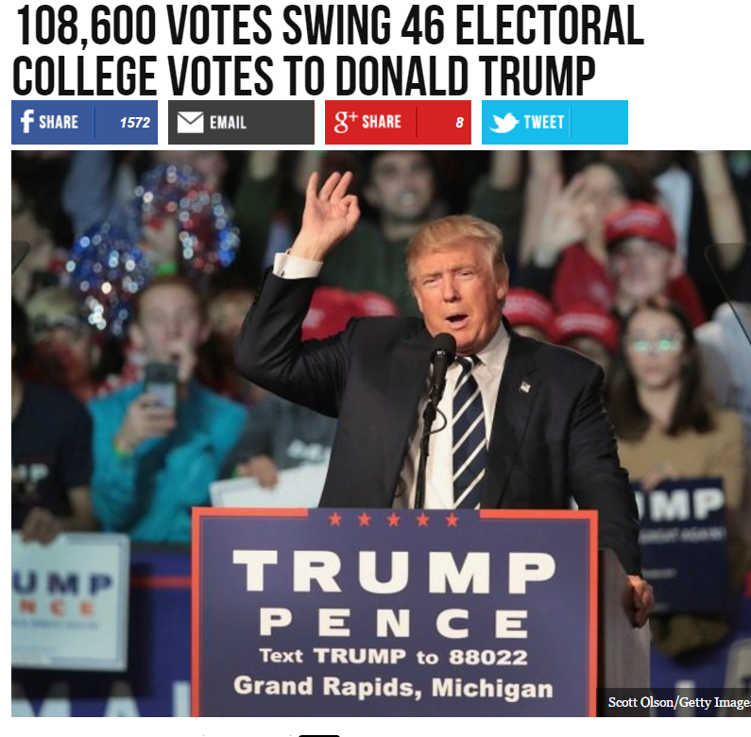
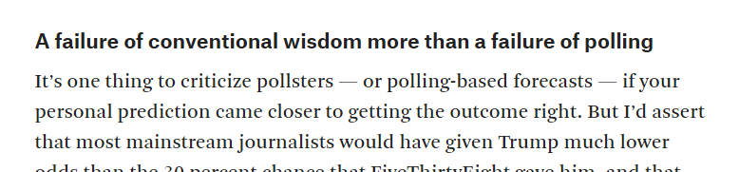

Slide 12
Challenges
Data Collection
more than a million tweets processed .
had to bypass twitter server blockings( twitter server blocks users if hit rate is high even)
Preprocessing the tweets
Analyzing the results – understanding the political process

Slide 13
THANKYOU !

